Slide 1


Experiment to determine Temple Run Distance
Liye Pan Chenxin Wang
Tingting Jiang Mohit Ghatikar

Slide 2
OUTLINE
Overview
Implementation
Analysis
Summary
Choice of Factors, Levels and Ranges
Selection of Response Variable
Design of the Experiment
Performing the Experiment
Normality Test
Two-way ANOVA
Regression Model
Analysis of the Residual Plots
Outline
Conclusion
Recommendation
Future Work

Slide 3
OUTLINE
Overview
Implementation
Analysis
Summary
Choice of Factors, Levels and Ranges
Selection of Response Variable
Design of the Experiment
Performing the Experiment
Normality Test
Two-way ANOVA
Regression Model
Analysis of the Residual Plots
Outline
Conclusion
Recommendation
Future Work

Slide 4
OUTLINE
Overview
Implementation
Analysis
Summary
Outline
Choice of Factors, Levels and Ranges
Selection of Response Variable
Design of the Experiment
Performing the Experiment
Normality Test
Two-way ANOVA
Regression Model
Analysis of the Residual Plots
Conclusion
Recommendation
Future Work

Slide 5
2
Choice of Factors, Levels and Ranges
Posture
Sound
New Player
Hand
Sit(+) / Stand(-)
One(+) / Two(-)
On(+) / Off(-)
Yes(+) / No(-)
Device
Brightness
Gender
Location
Iphone(+)
/ipad(-)
100%(+) /30%(-)
Female(+) / Male(-)
Library(+) /Outside(-)

Slide 6
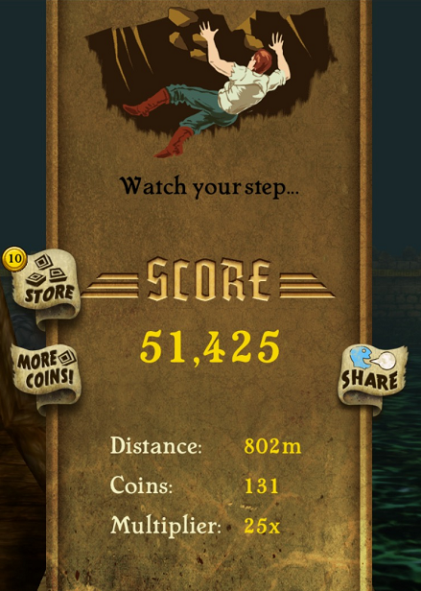
2
Selection of Response Variable
Response :
Distance

Slide 7
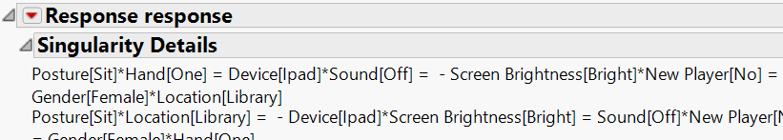
2
Design of the Experiment (SAS JMP Screening Design)
Design of the Experiment--Fractional Factorial Design
2_{IV}⁸⁻⁴, 16 runs
Generator: posture*hand = device * sound
posture = hand * device * sound
Defining relation: I = posture*hand*device*sound
= screen*new player*gender*location…
Resolution: IV balances in between, budget/time vs. accuracy issue
Design of the Experiment Number of Replicates 4
Randomization
Number of Replicates 4

Slide 8
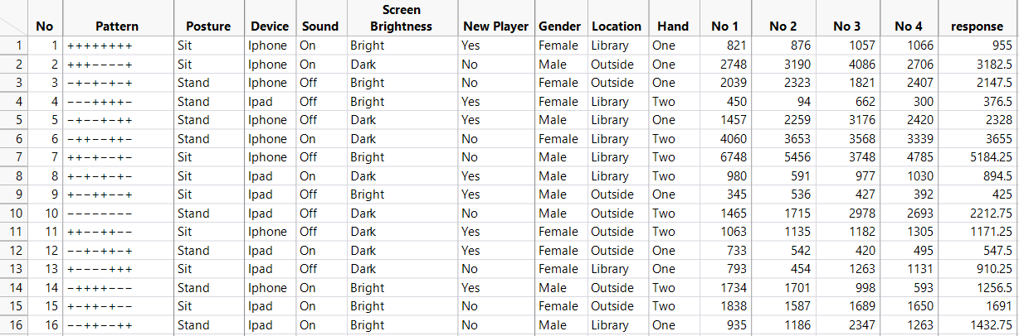
2
Design of the Experiment

Slide 9
OUTLINE
Overview
Implementation
Analysis
Summary
Choice of Factors, Levels and Ranges
Selection of Response Variable
Design of the Experiment
Performing the Experiment
Normality Test
Two-way ANOVA
Regress\ion Model
Analysis of the Residual Plots
Outline
Conclusion
Recommendation
Future Work

Slide 10
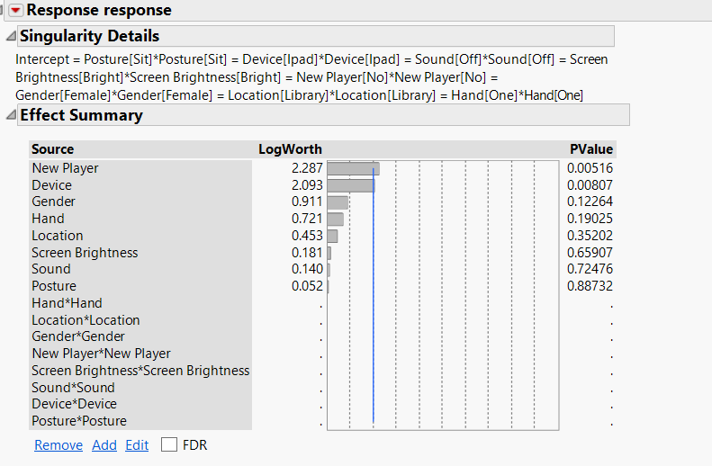
3
Generator & Confounding Factors

Slide 11
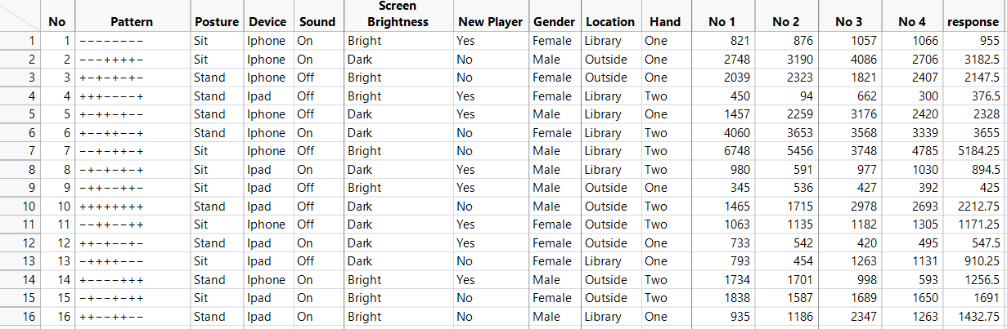
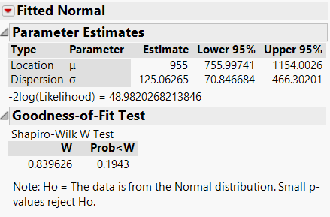
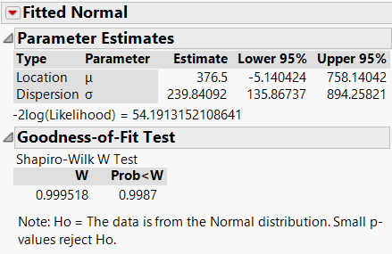
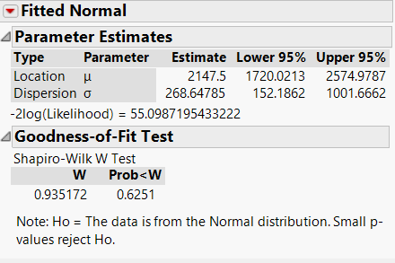
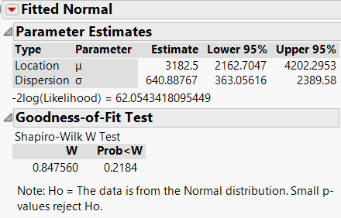
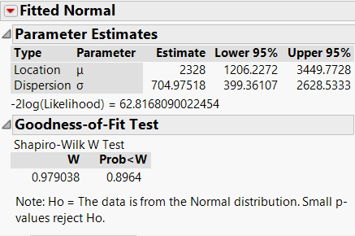
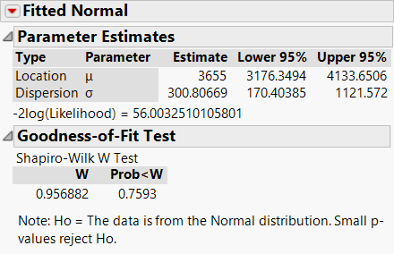
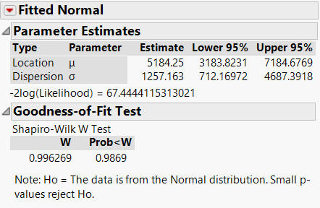
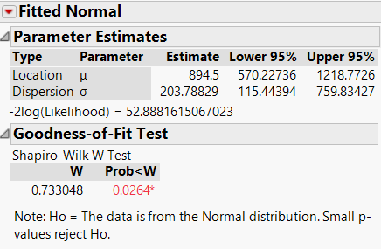
3
Normal Test
Row 1
Row 2
Row 3
Row 4
Row 5
Row 6
Row 7
Row 8

Slide 12
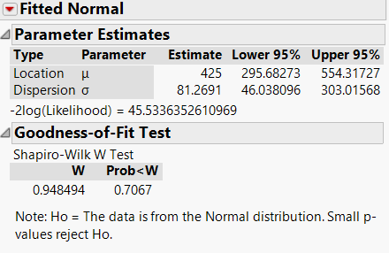
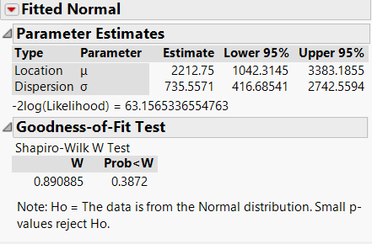
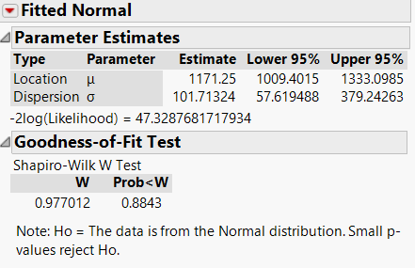
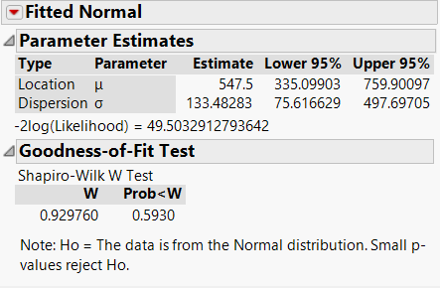
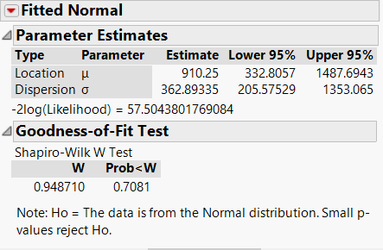
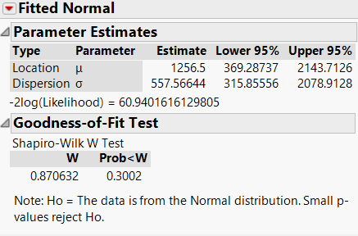
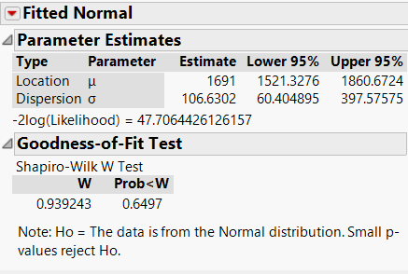
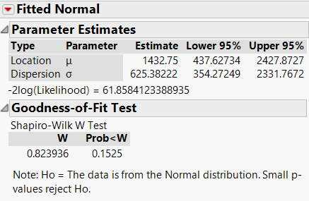
3
Normal Test
Row 9
Row 10
Row 11
Row 12
Row 13
Row 14
Row 15
Row 16

Slide 13
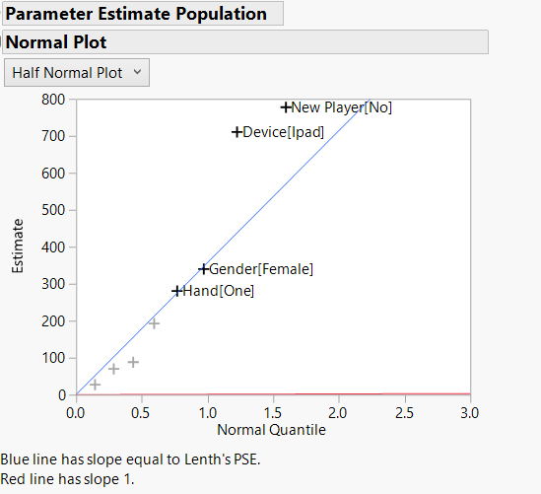
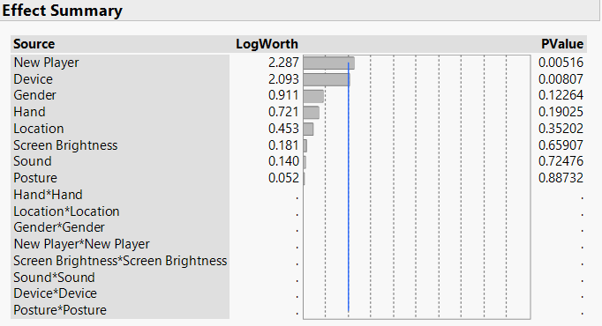
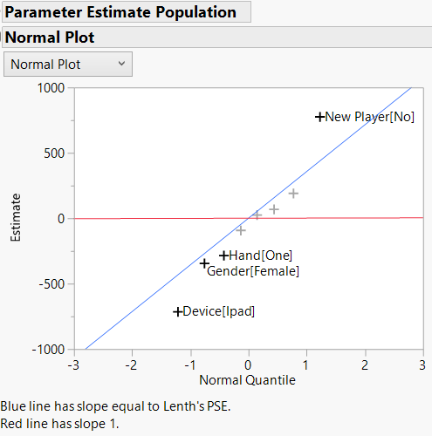
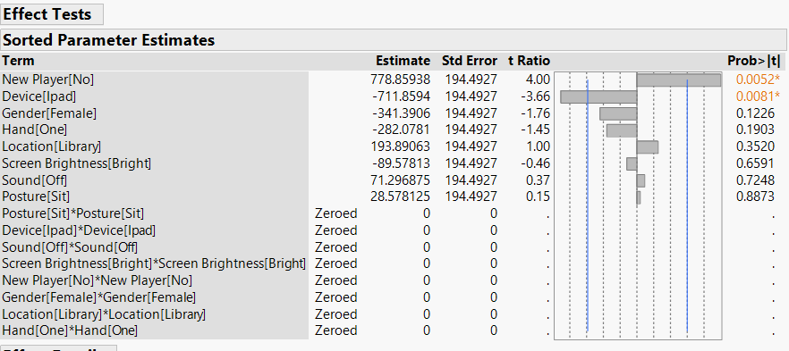
3
Normal Plot

Slide 14
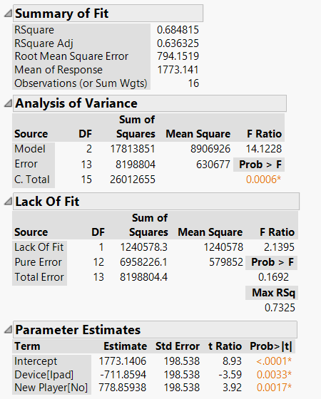
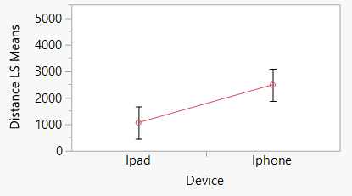
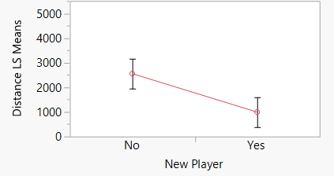
3
Regression Modeling
Regression Equation
Distance = 1773.14
+ 711.86 * Device
- 778.86 * NewPlayer
Model Summary

Slide 15
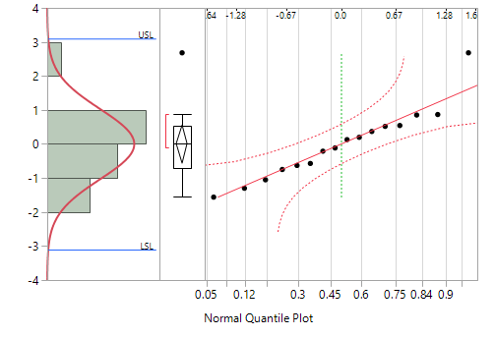
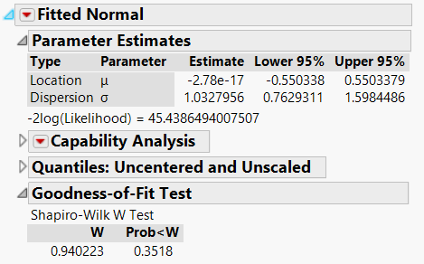
3
Studentized Residual Analysis
Normal Quantile Plot
Normal Test of Studentized Residual
From the plot we could see that residual seems to follow normal distribution generally.
Ho = The data is from the Normal distribution. Small p-values reject Ho.
The P-value of Shapiro-Wilk W Test for residual is 0.3518 > 0.05, so we accept Ho, we can say the residuals are normally distributed with confidence of 95%.

Slide 16
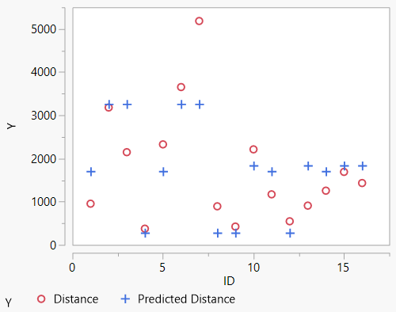
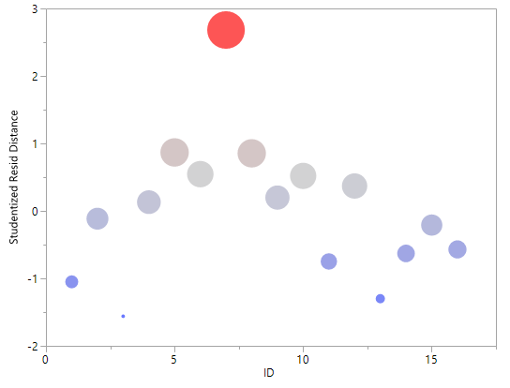
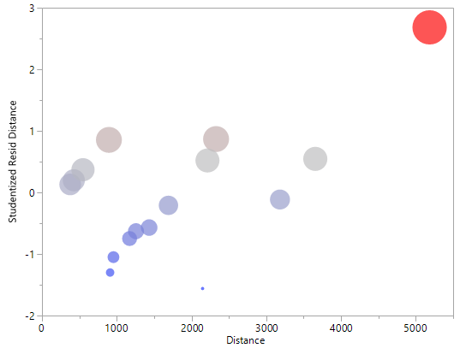
3
Studentized Residual Analysis
Outlier
Predicted Distance
VS
Real Distance
Residual by ID
Residual by Distance
Why Studentized Residual:
Typically the standard deviations of residuals in a sample vary greatly from one data point to another even when the errors all have the same standard deviation, particularly in regression analysis; thus it does not make sense to compare residuals at different data points without first studentizing. It is a form of a Student's t-statistic, with the estimate of error varying between points.
This outlier is run that :
Male & not new player & Iphone & in the library & two hands & sitting & sound off & bright screen. The predicted value is 3,264, and the real distance is 5,184.

Slide 17
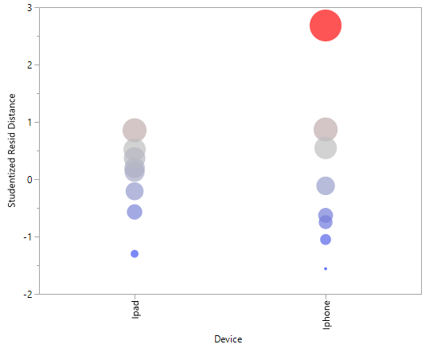
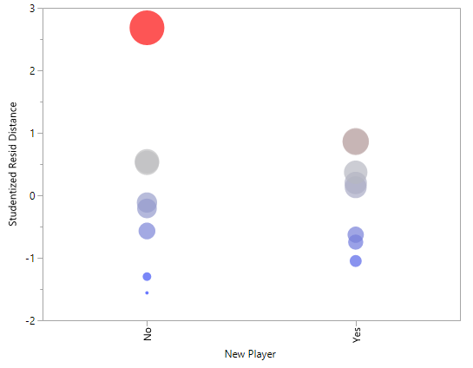
3
Studentized Residual Analysis
Residual by Factor: Device
Residual by Factor:
New Player

Slide 18
OUTLINE
Overview
Implementation
Analysis
Summary
Choice of Factors, Levels and Ranges
Selection of Response Variable
Design of the Experiment
Performing the Experiment
Normality Test
Two-way ANOVA
Regression Model
Analysis of the Residual Plots
Outline
Conclusion
Recommendation
Future Work

Slide 19
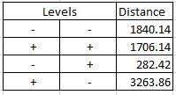
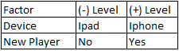
4
Results
Regression Equation
Distance = 1773.14
+ 711.86 * Device
- 778.86 * New Player
From our results, we obtain the highest distance if the Device is Iphone and the player has played this game before.
Since other factors are insignificant, we can choose any level for these factors.
Brightness can be low (30%) to reduce battery usage.
The sound can be turned off .
The location setting and the posture makes no difference.
The player can choose to play with either one hand or both the hands, i.e whichever they are most comfortable with.

Slide 20


4
Future References
We can test for android devices.
We can experiment with different characters.
We can optimize for in game add-ons like Powerups and Utilities.

Slide 21

Thank you for watching

